Slide 1
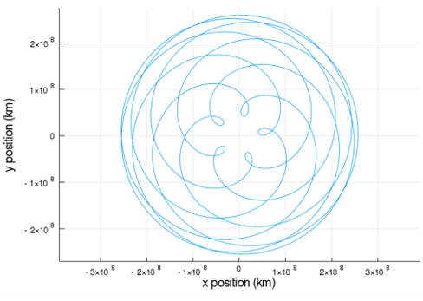


Julia 1.2 Ephemeris Reader and Gravitational Modeling Program
Kaela Martin, Parker Landon
Embry-Riddle Aeronautical University

Slide 2
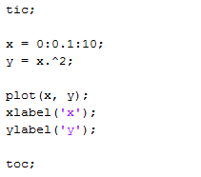
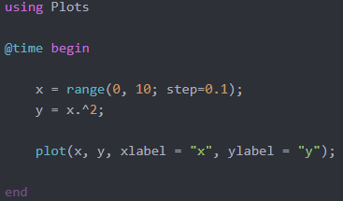
Julia is a fast, dynamic programming language designed for scientific computing.
MATLAB execution time: 100 ms
Julia execution time: 1 ms
Notes:
Julia is 2x as fast as MATLAB in most cases.
Open source and free, no licenses.
Looks like MATLAB so it’s easy to move to.
Julia 100x faster in this case. (Not a real benchmark!)

Slide 3
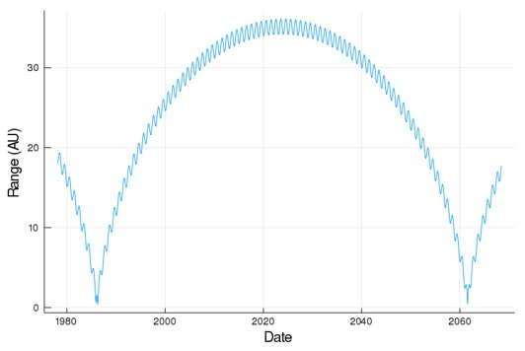
BodyDataReader is a Julia package designed to retrieve data from JPL Horizons.

Slide 4
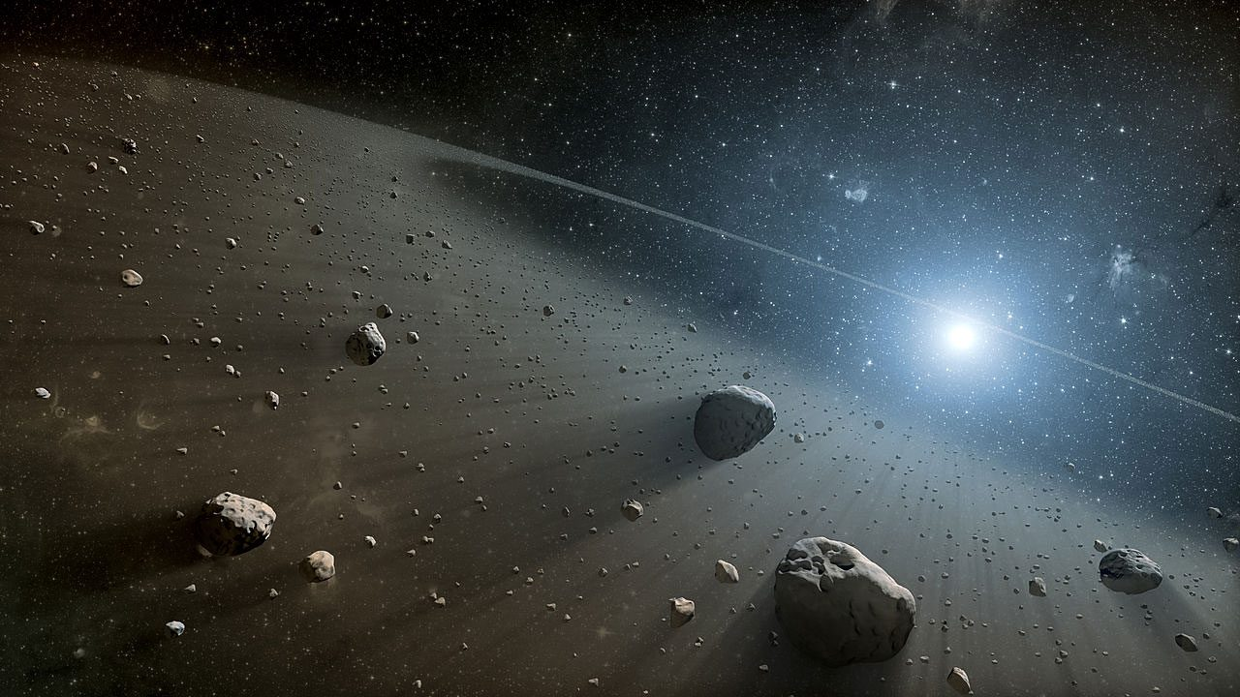
We have developed a package, astromod, that retrieves properties of asteroids.
[1]

Slide 5
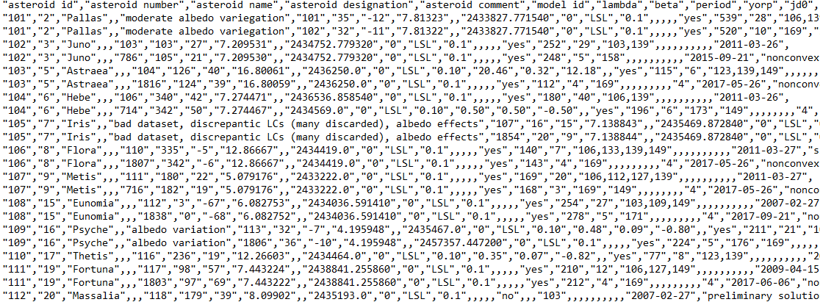
DAMIT provides text that our program can use to pull the user requested asteroid properties.

Slide 6
The program uses the input data to parse the DAMIT database and output the requested values.
Input | Output
julia>astermod([”Psyche”],[”equivalent diameter”]) | ["asteroid id" "model id" "equivalent diameter"] ​ ["===", "===", "===", "==="] ​ ["109", "113", "211"] ​ ["109", "1806", "224"] ​ ["===", "===", "===", "==="] ​

Slide 7
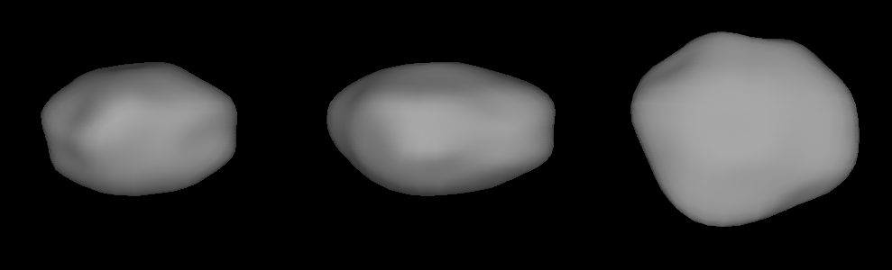
DAMIT also provides three-dimensional asteroids models that can be used to produce gravitational field models.
[2]
[5]

Slide 8
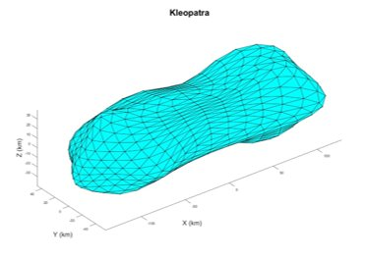
The program recreates these asteroid models and solves for the acceleration at the user defined point.

Slide 9
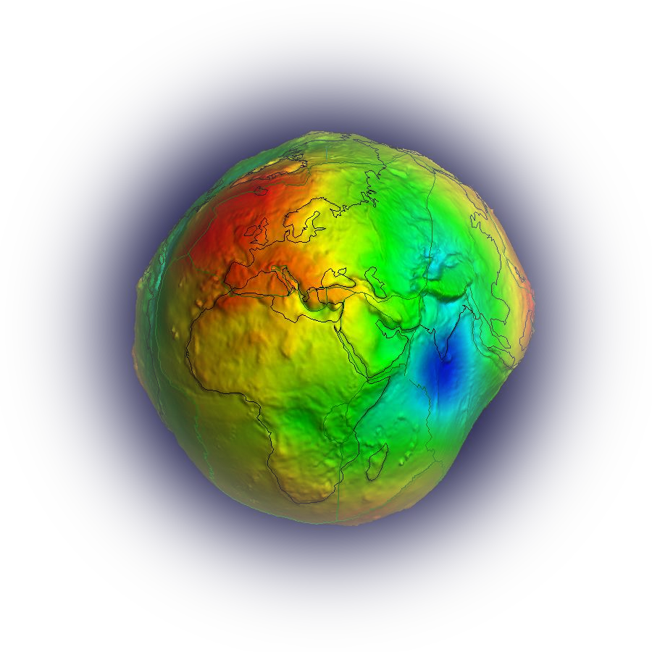
The program can also utilize spherical harmonics to solve for gravitational potentials.
[3]

Slide 10
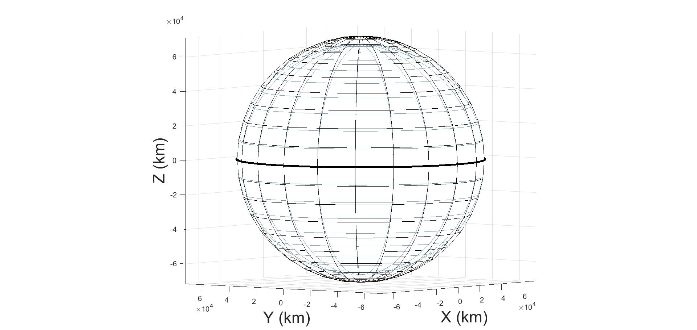
Alternatively the program has a method to solve for acceleration using the Brillouin sphere and moments of inertia.

Slide 11
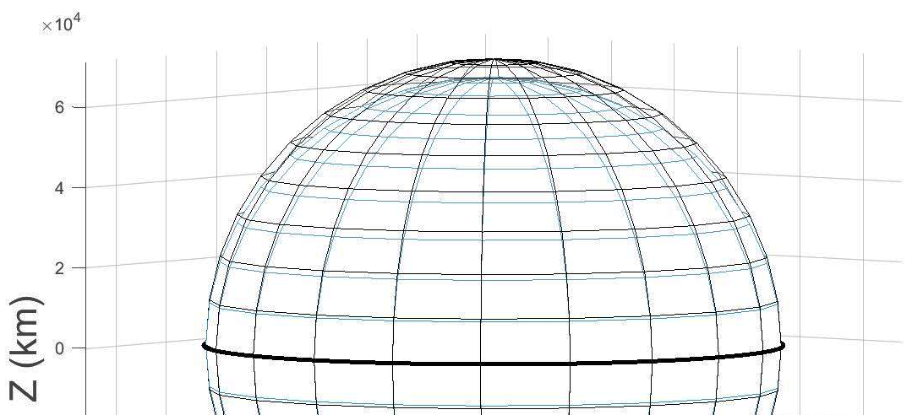
This method requires separate solutions for field points within the Brillouin Sphere

Slide 12
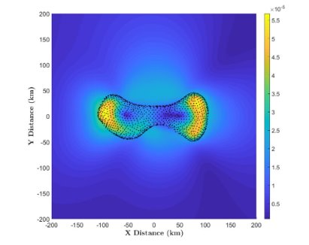
In the future, we plan to transfer additional packages to Julia and expand the program’s capabilities.
Transfer modeling to Julia
[2]
[5]
Implement downloading asteroid shape files
[1]
Notes:
Complete the polyhedron gravitational modeling
Reconstruct the astermod function to be more versatile
Implement the capability to download and present asteroid shape files
Optimize the subfunctions to reduce the runtime
Implement features that enable compatibility with Spice files
Add higher order spherical harmonics

Slide 13
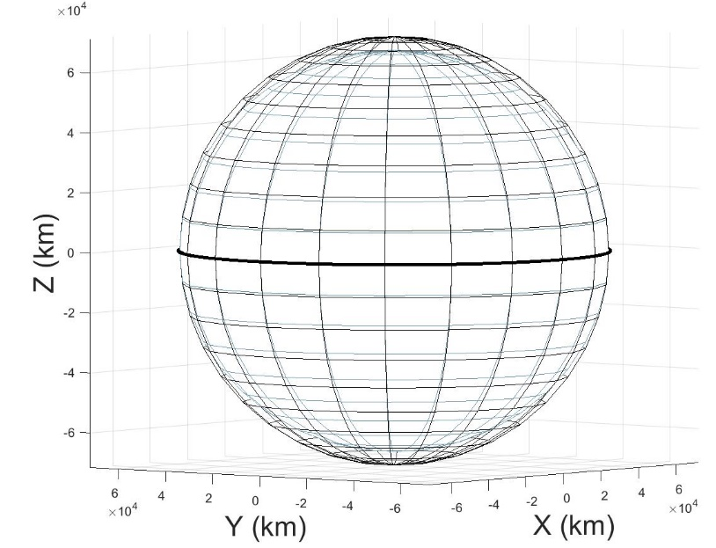
In summary, BodyDataReader is fully functional and other packages are in progress.
Ephemeris Reader
Spherical Harmonics
[3]
Brillouin Sphere
Polyhedral Modeling
[2]

Slide 14

We would like to give a big thank you to those who have supported us!
Notes:
Dr. Kaela Martin and Dr. Damon Landau
Anne Boettcher and Virginia MacGowan and The Embry-Riddle Aeronautical University Undergraduate Research Institution

Slide 15
In summary, Ephemeris Reader is fully functional and other packages are in progress.
Ephemeris Reader
Spherical Harmonics
Questions?
[3]
Brillouin Sphere
Polyhedral Modeling
[2]

Slide 16
References
[1] https://www.sciencemag.org/careers/2016/07/looking-space-asteroid-miner
[2] https://astro.troja.mff.cuni.cz/projects/asteroids3D/data/archive/1-1000/A109.M1806.shape.png
[3] http://icgem.gfz-potsdam.de/home
[4] Liapis, N., “Feasibility of Circular Orbits for Proximity Operations in Strongly Perturbed Environments Around Uniformly Rotating Asteroids,” Thesis, Embry-Riddle Aeronautical University, August 2019​

